Slide 1
Recommendation Systems
Seminar: Information Systems

Slide 2
Data explosion in past years
Paradox of choice
Not choose anything at all
OR
Choose multiple things - get FOMO

Slide 3






Enter… Recommendation systems!

Slide 4
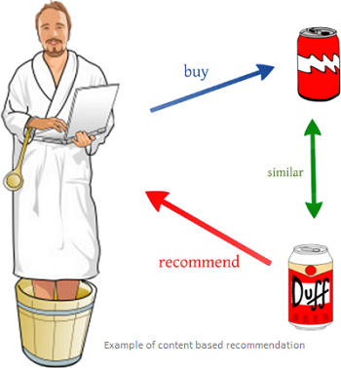
Evolution
Content based systems

Slide 5
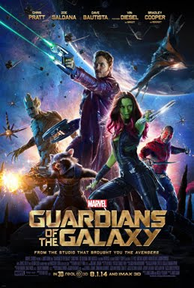
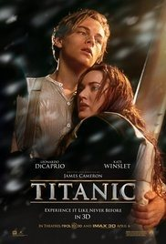

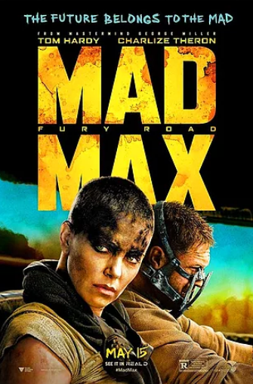



Collaborative
filtering
Sabi
Jorjito
Seba
AMac
Meera
Mei
Kiri
Khali
Xubaobao

Slide 6
What problems does a Recommendation system solve and what do we gain from it?
What is required to build a recommendation system?
What is needed to maintain such a system?

Slide 7


Recommend: space exploration movies

Slide 8


Result: confused algorithm

Slide 9
Product recommendations
Tricky data - IDs
ID-52 and ID-53 vs ID-52 and ID-62
What if the IDs mean something?

Slide 10
Enter…
Prod2vec – similar to word2vec
Embedding of users and products
Products that appear closer on a plot will be similar

Slide 11
Problem?
User query: Curry
Recommended item?
We need context / side information

Slide 12
With linear regression models -> correct item corresponding to the query
Problem?
Same item recommended every time

Slide 13
Enter…
Deep learning -> generalize recommendations, diversity
Problem?
Too much generalization

Slide 14
Let’s combine both linear models and deep learning
Enter…
Wide + Deep learning

Slide 15
Wide + Deep learning
Memorization and generalization
Memorization: “can be loosely defined as learning the frequent co-occurrence of items or features and exploiting the correlation available in the historical data.”
Generalization: “is based on transitivity of correlation and explores new feature combinations that have never or rarely occurred in the past.”

Slide 16
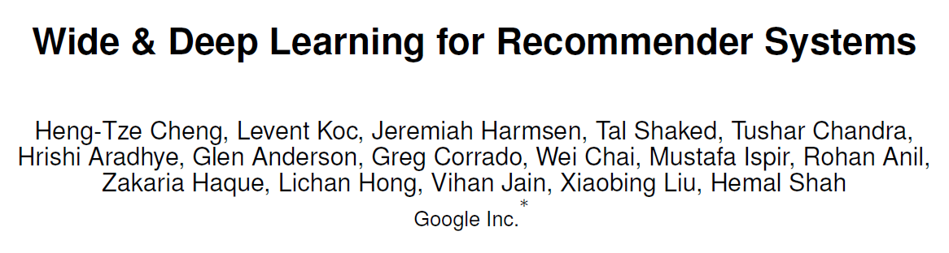
Inspiration:

Slide 17
Our data:
Grocery recommendation – Instacart
Not enough research + high potential

